Slide 1
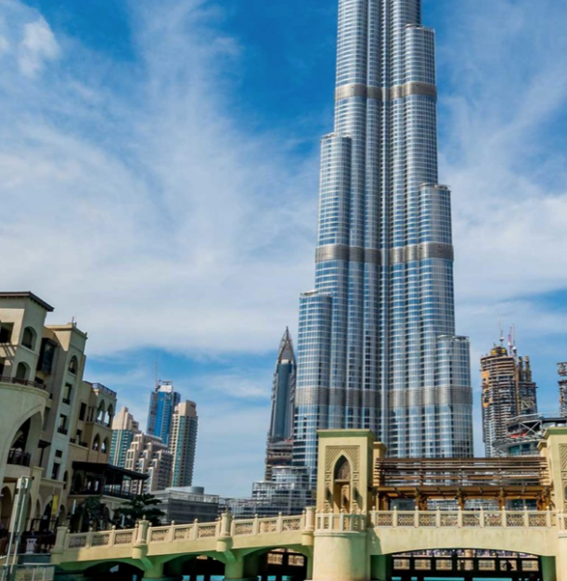

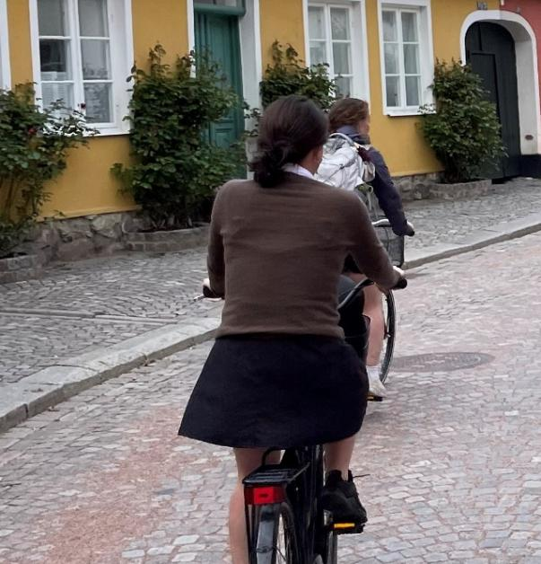
Systems
Global
Consulting
DUBAI
SWEDEN
ARGENTINA

Slide 2
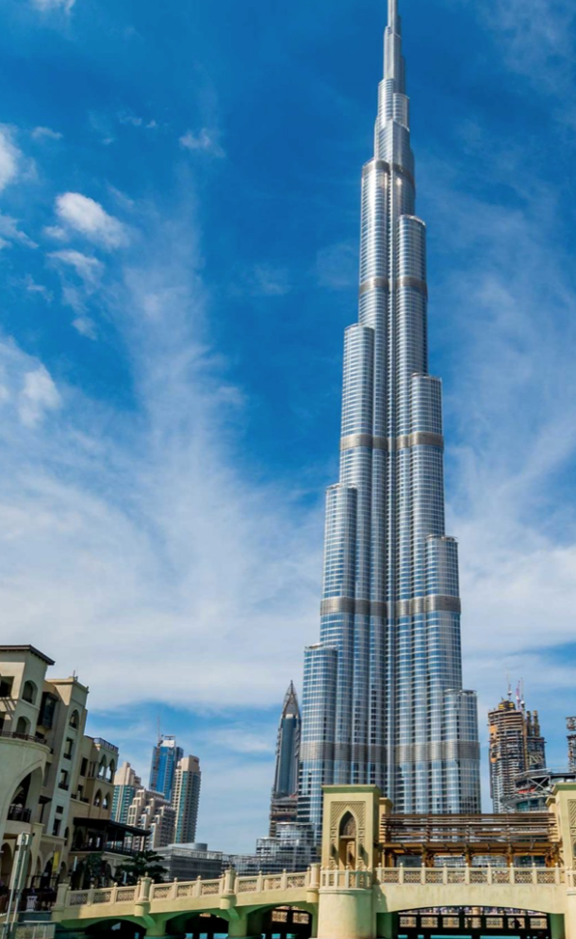
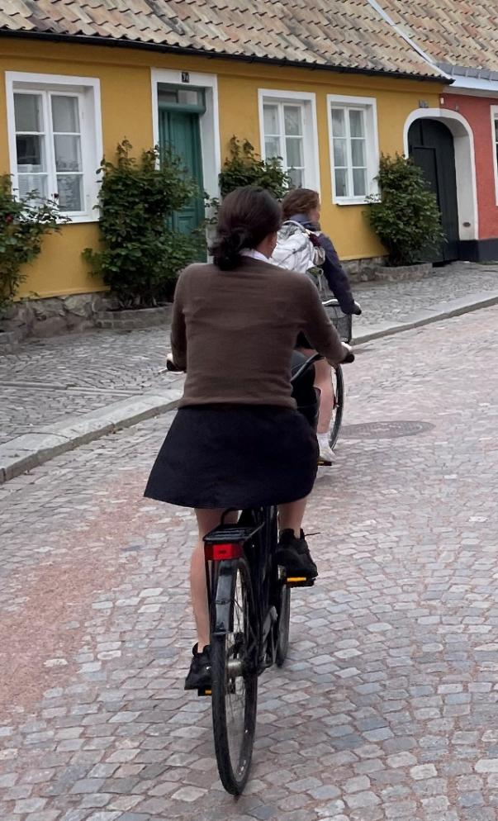

Systems
Global
Consulting
DUBAI
SWEDEN
ARGENTINA

Slide 3
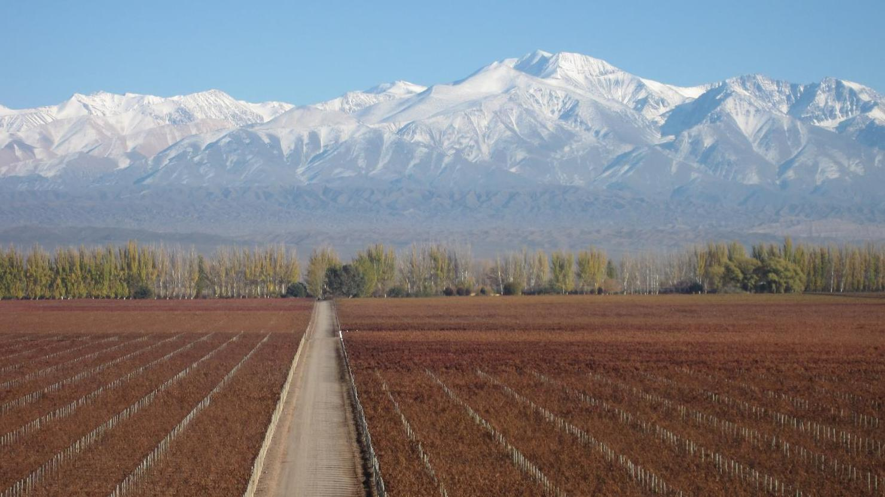
Systems
Global
Consulting
“Learning in this kind of setting taught me more than any of the classes at school.”
Notes:
Tell the story. From this – to there with students.

Slide 4
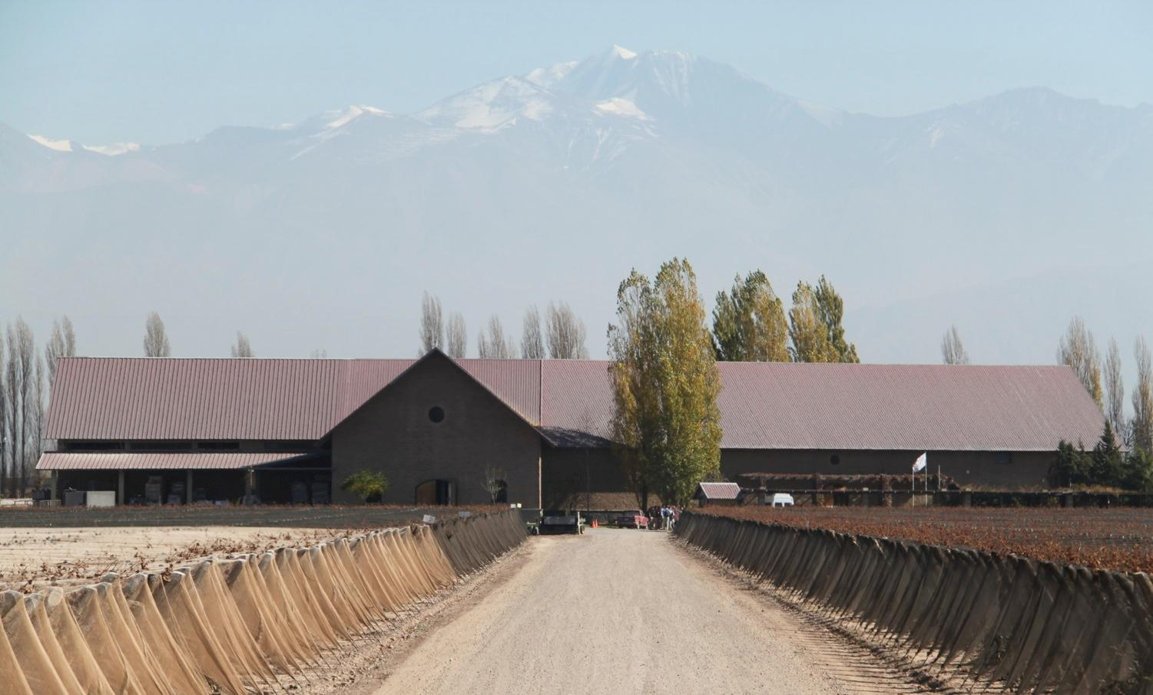
Systems
Global
Consulting
J-TERM
ARGENTINA
We
are a group
of professionals
working together for clients
on 2-3 week projects.
Notes:
Tell the story. From this – to there with students.

Slide 5
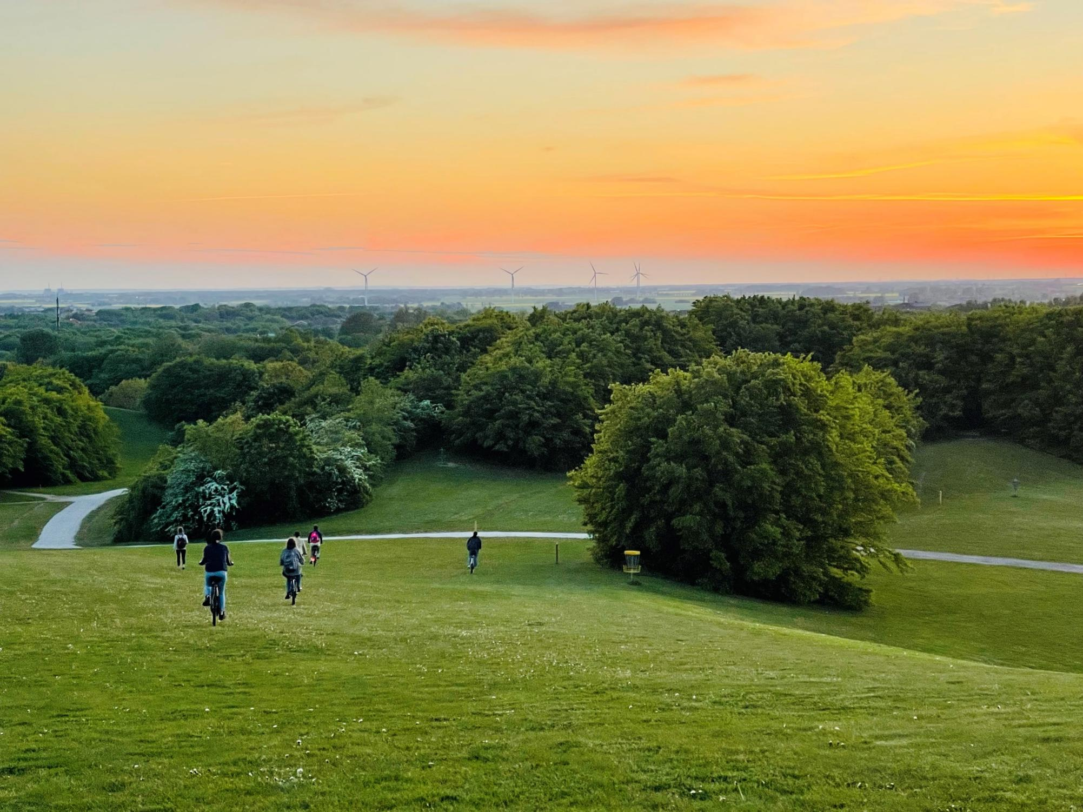
Systems
Global
Consulting
SWEDEN
MAY-TERM
Notes:
READ Course Evals from 2023

Slide 6
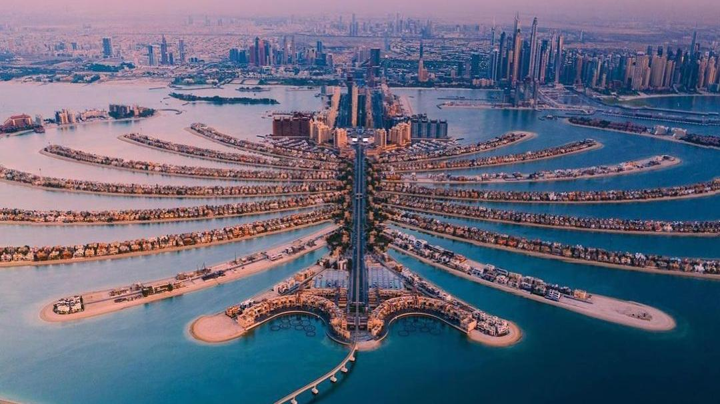
Systems
Global
Consulting
DUBAI
J-TERM
Notes:
Welcome to Dubai program.
What drives the success of these programs?

Slide 7
AUTHENTIC WORK

Slide 8
We work hard We deliver results
AUTHENTIC WORK

Slide 9
We work hard We deliver results
The engine of this program is fully focusing on delivering results that matter to clients.
This client focus
allows us to experience culture richly in a short amount of time
sets the role of faculty as being to help you deliver value to the clients, not to them
allows you to learn content deeply

Slide 10
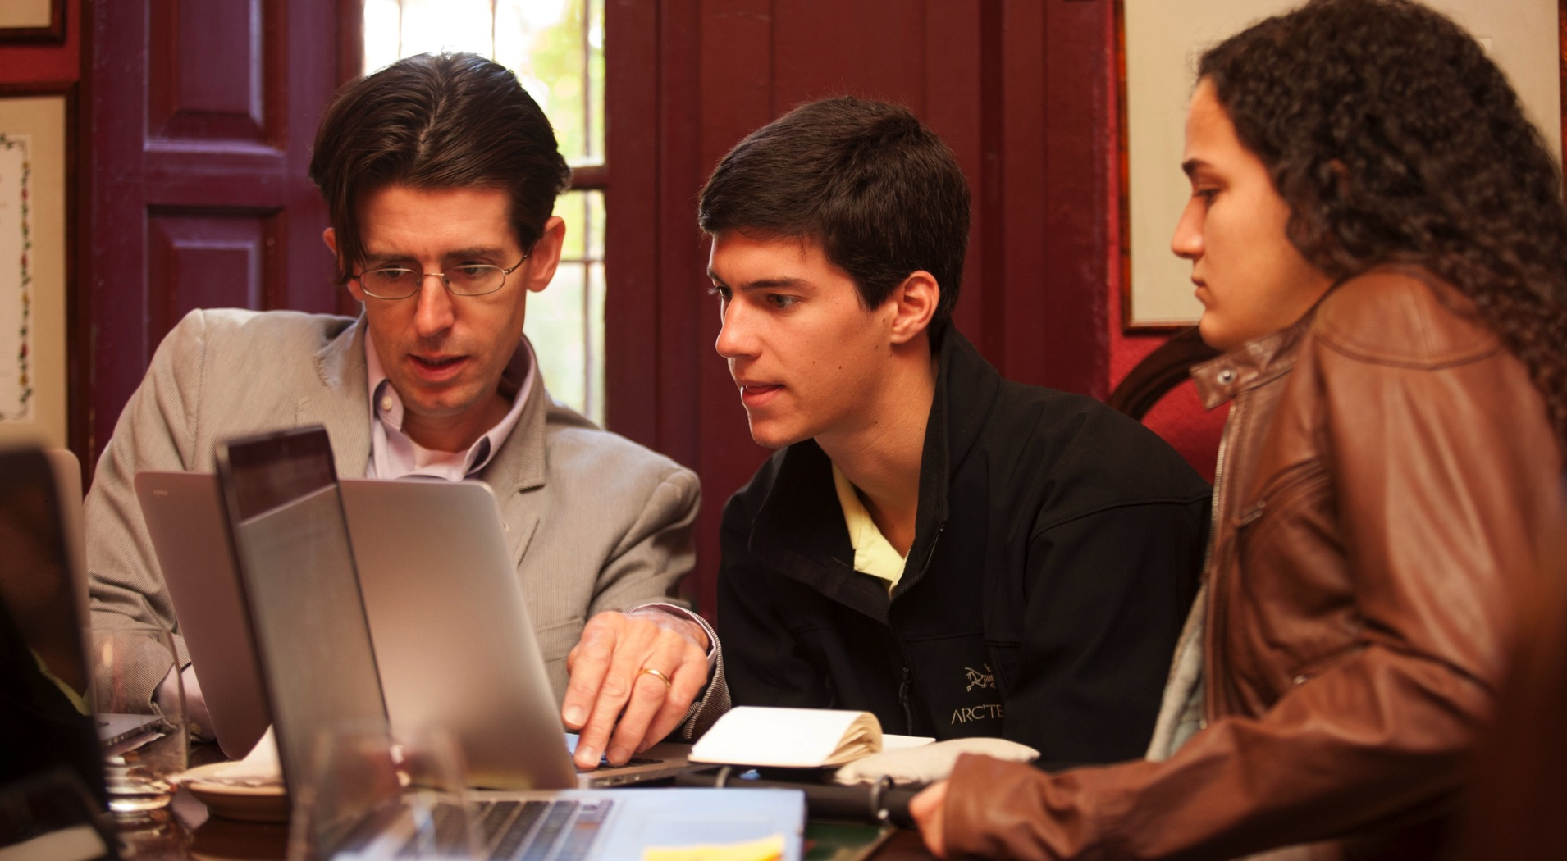

Slide 11


Slide 12
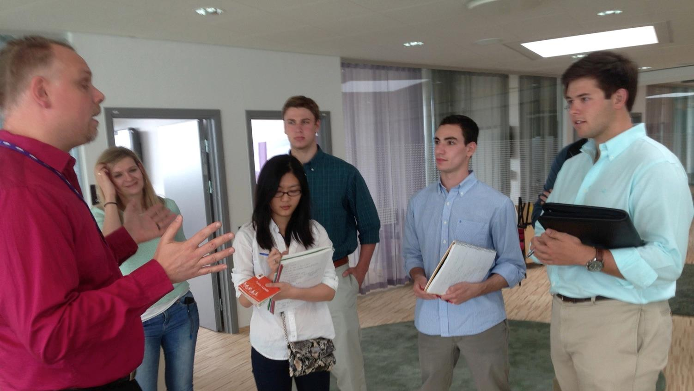

Slide 13
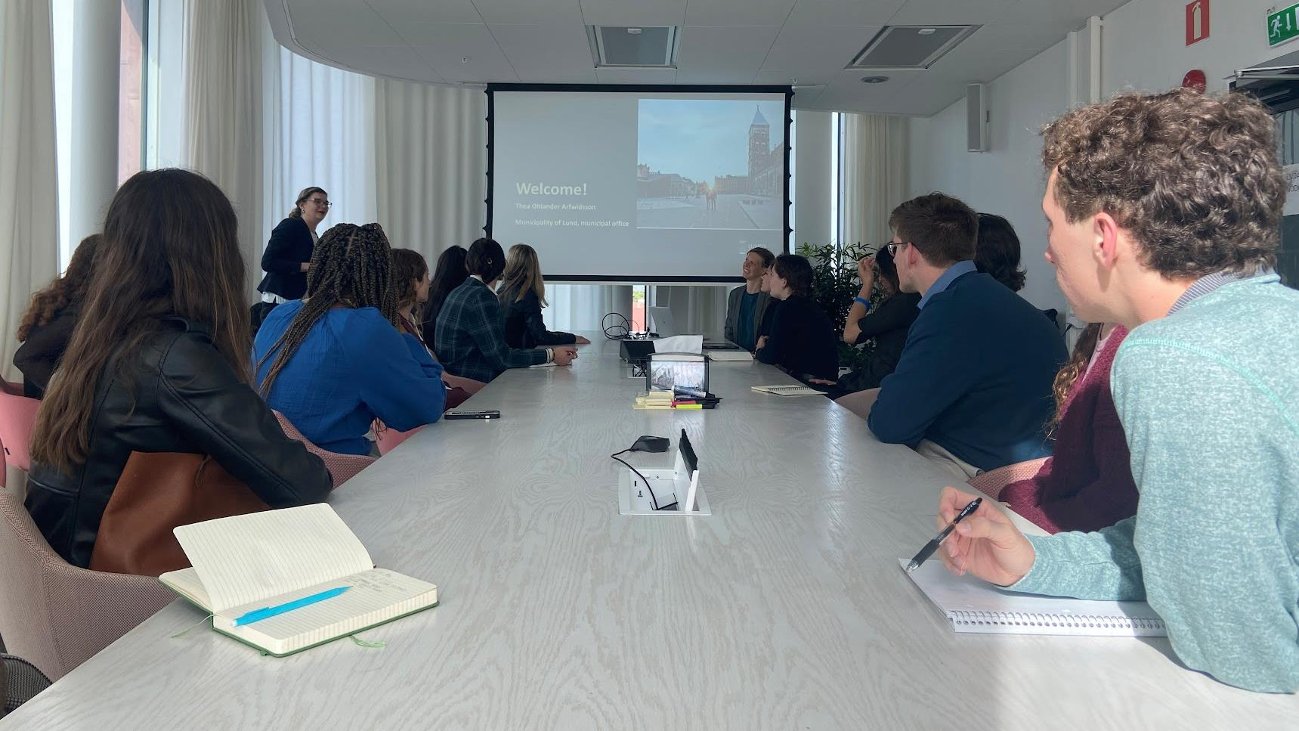

Slide 14
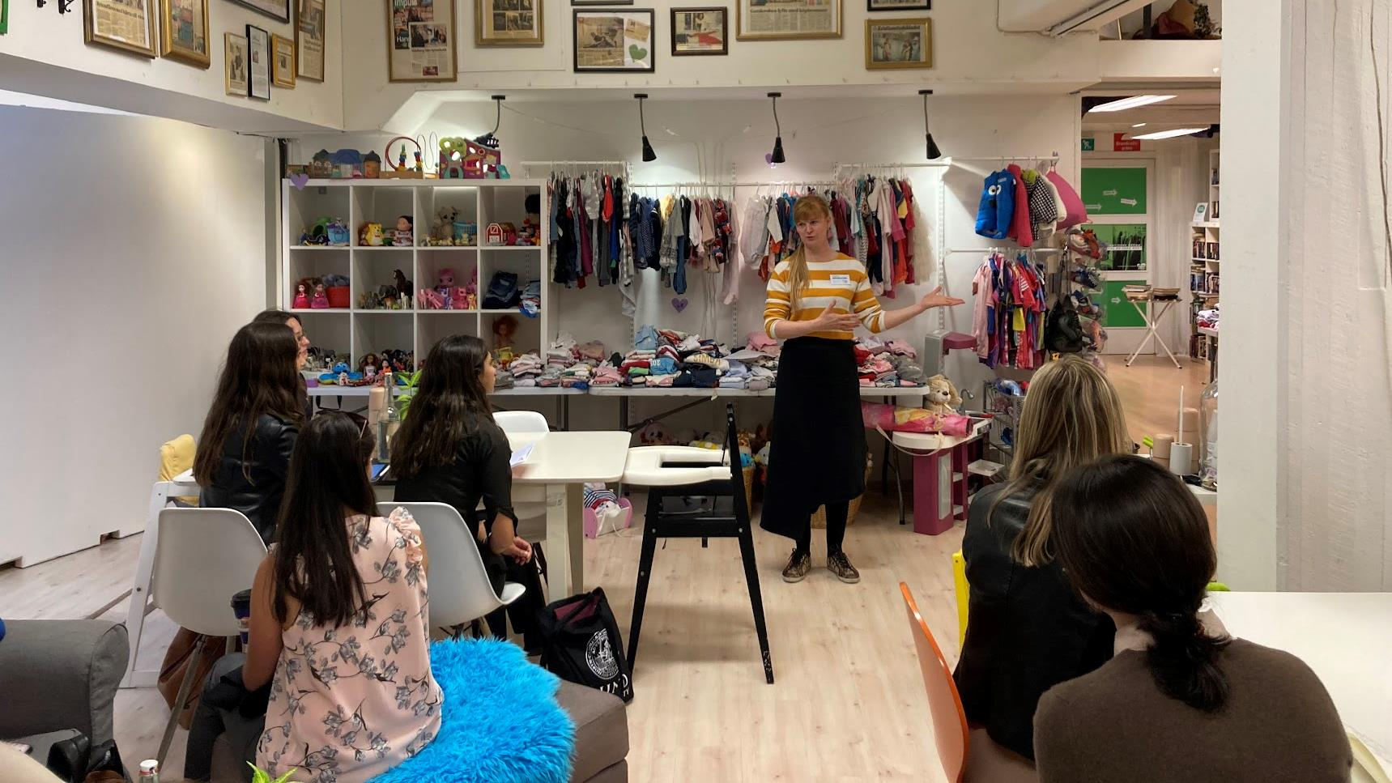

Slide 15
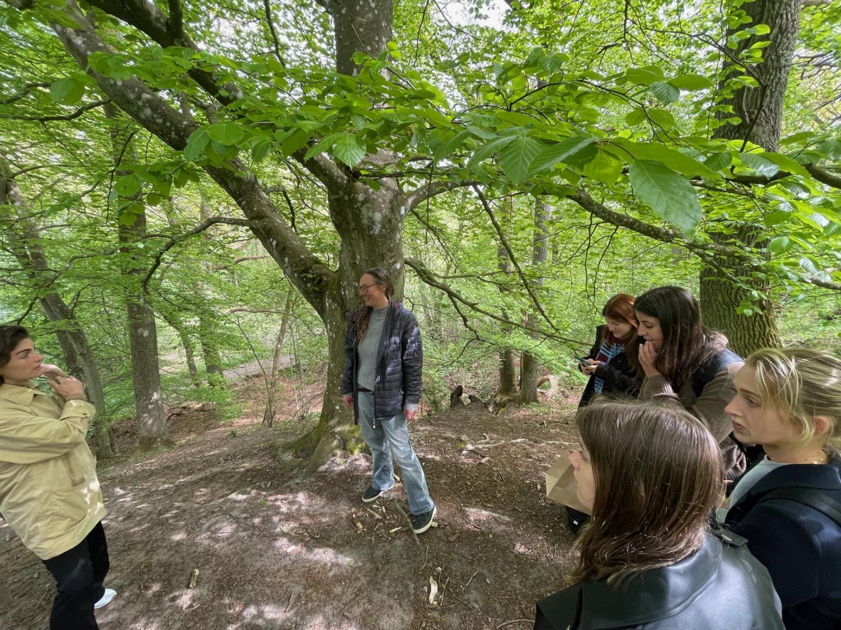

Slide 16
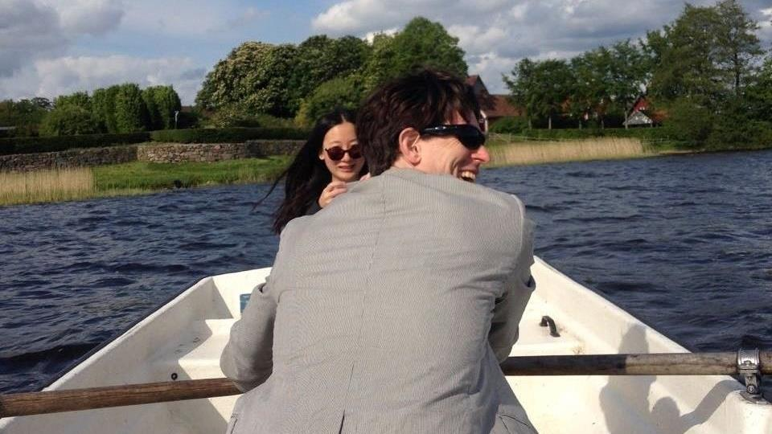

Slide 17
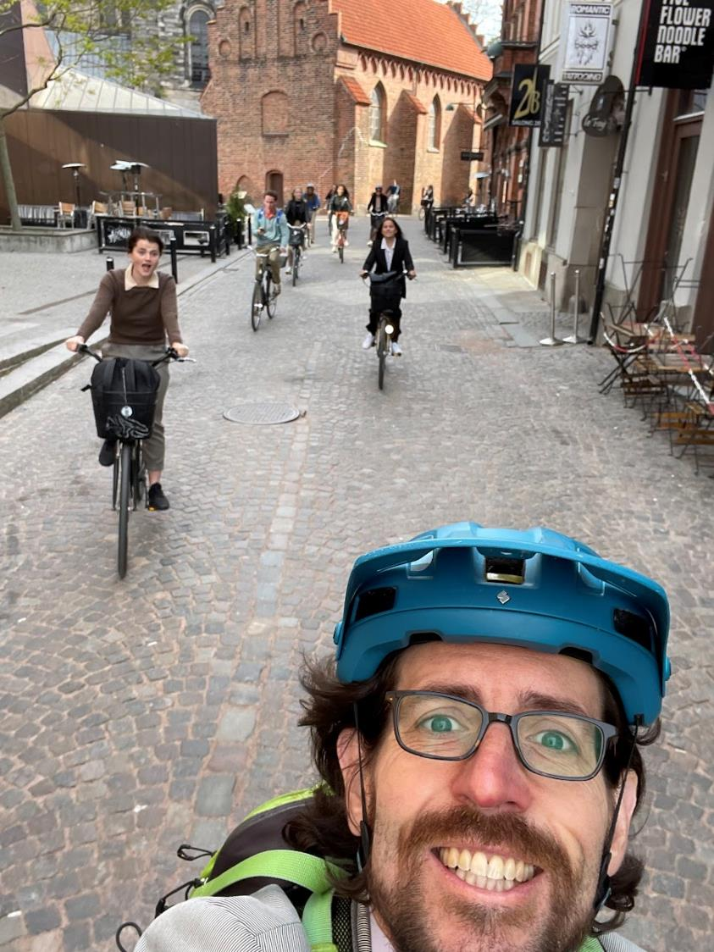
DEPTH
2-3 Weeks
One City
One Client
One Project

Slide 18
Learn content deeply
Experience culture richly
2-3 Weeks
One City
One Client
One Project

Slide 19
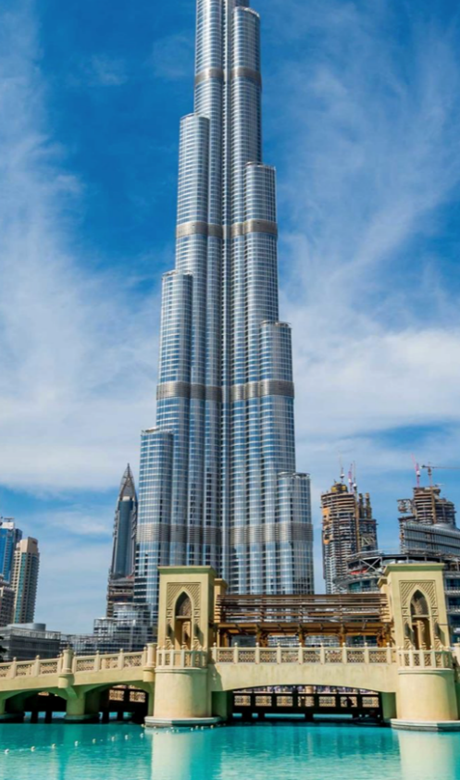

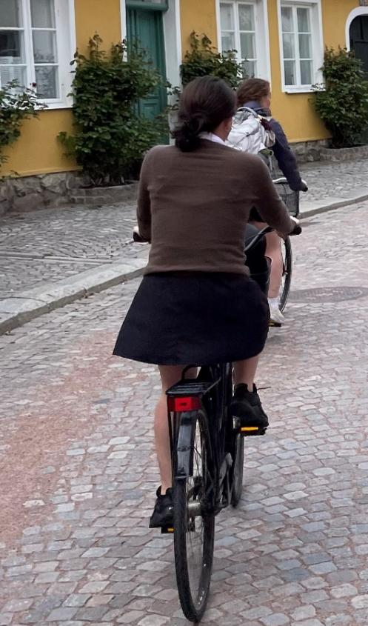
J-term
J-term
May-term
Entrepreneurship
Technology
Sustainability
ARGENTINA
SWEDEN
DUBAI

Slide 20
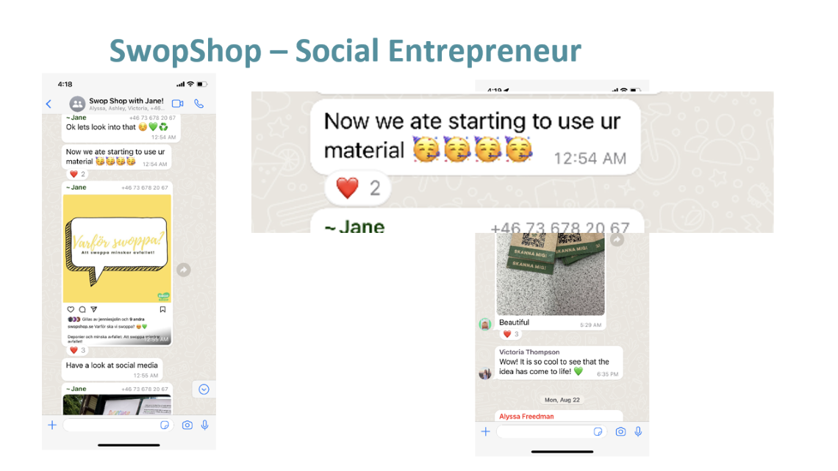

May-term
Sustainability
SWEDEN

Slide 21
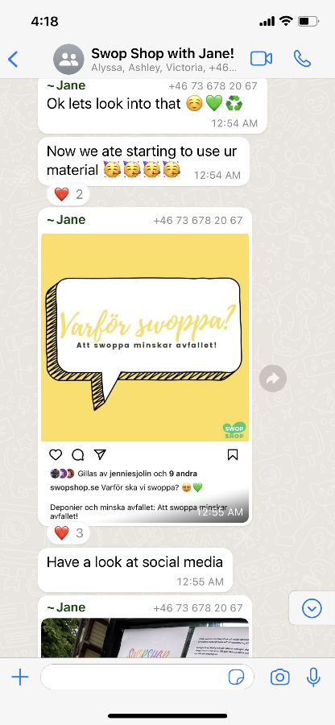
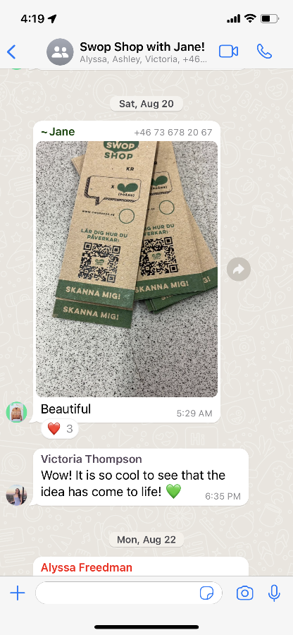
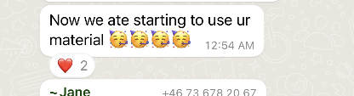
SwopShop – Social Entrepreneur

Slide 22
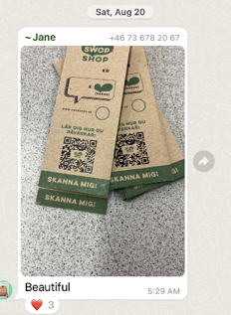
SwopShop – Social Entrepreneur

Slide 23
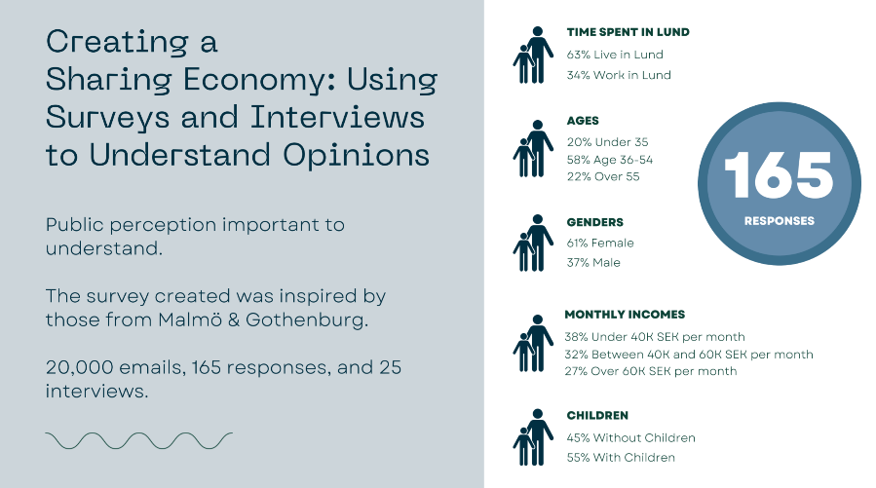
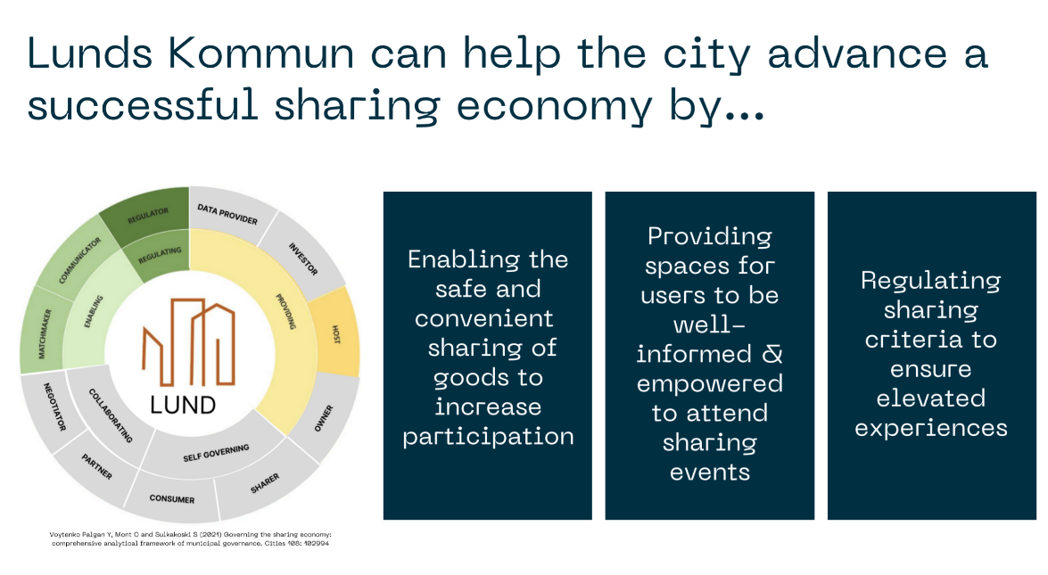
Promoting Circular Economy - City

Slide 24

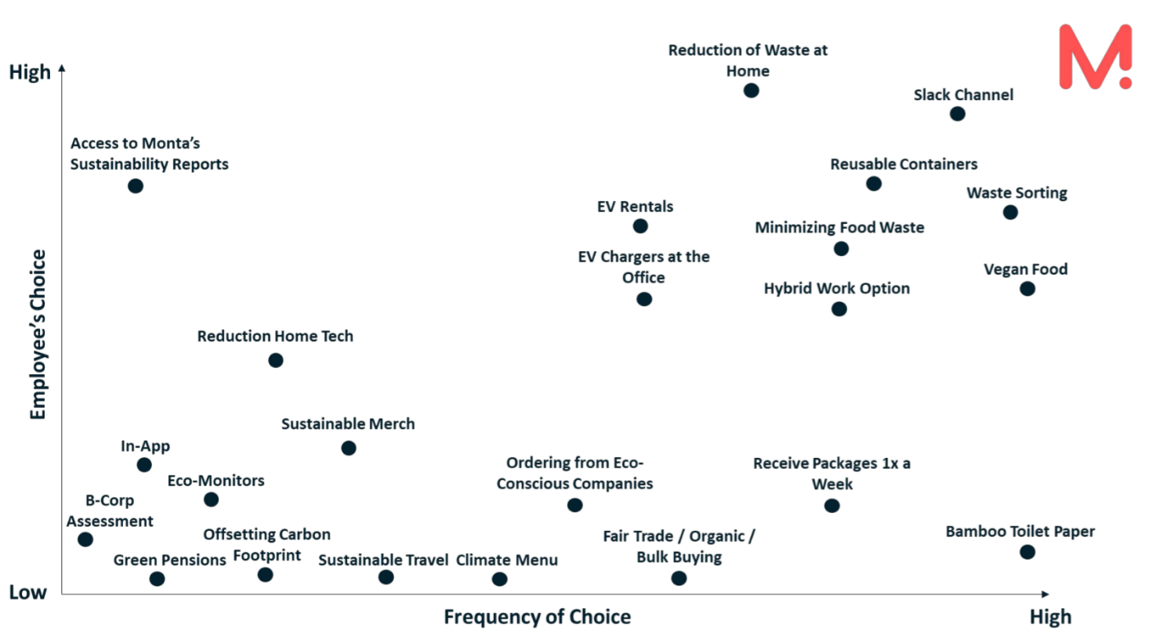
Green Initiative Strategy for Monta- Tech Start up

Slide 25
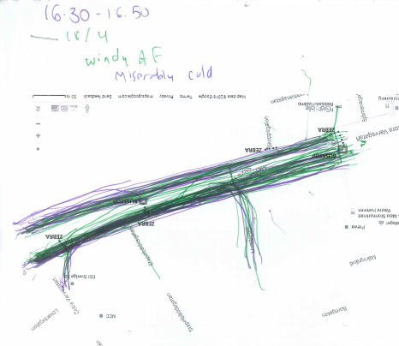
Measuring Sidewalk Traffic – Non-profit

Slide 26
What do you do besides work on the client projects?

Slide 27
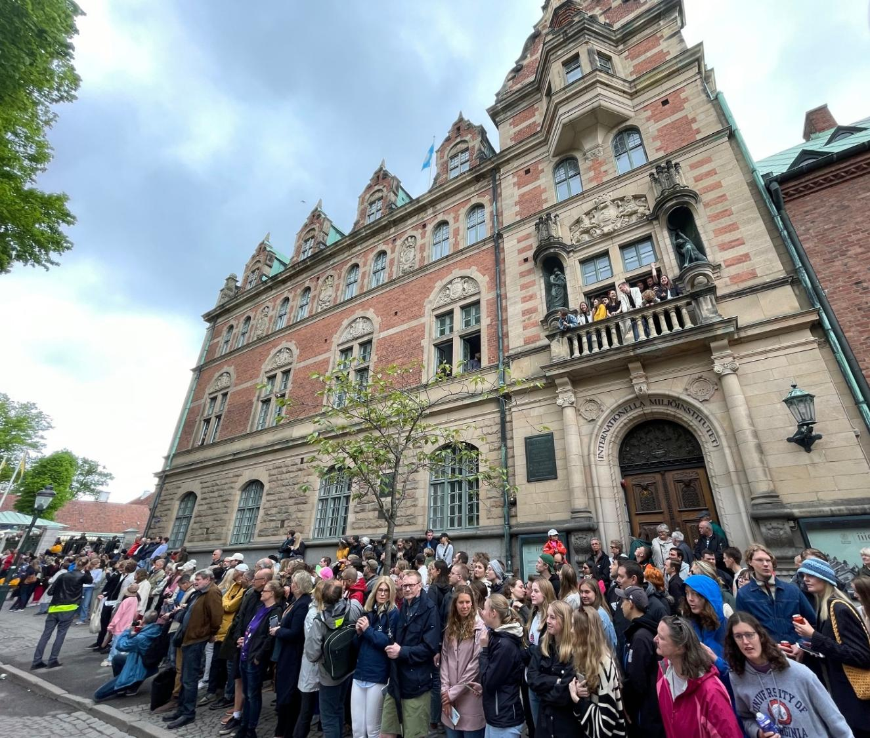
What do you do besides work on the client projects?
Interact with and receive a few talks from our IIIEE colleagues
Bike around a lot!
Tour a large scale waste handler – incinerates trash to heat Malmö
Tour Vastra Hamnen, a model of sustainable urban development built on the old site of a major shipbuilding yard
Bornholm!

Slide 28
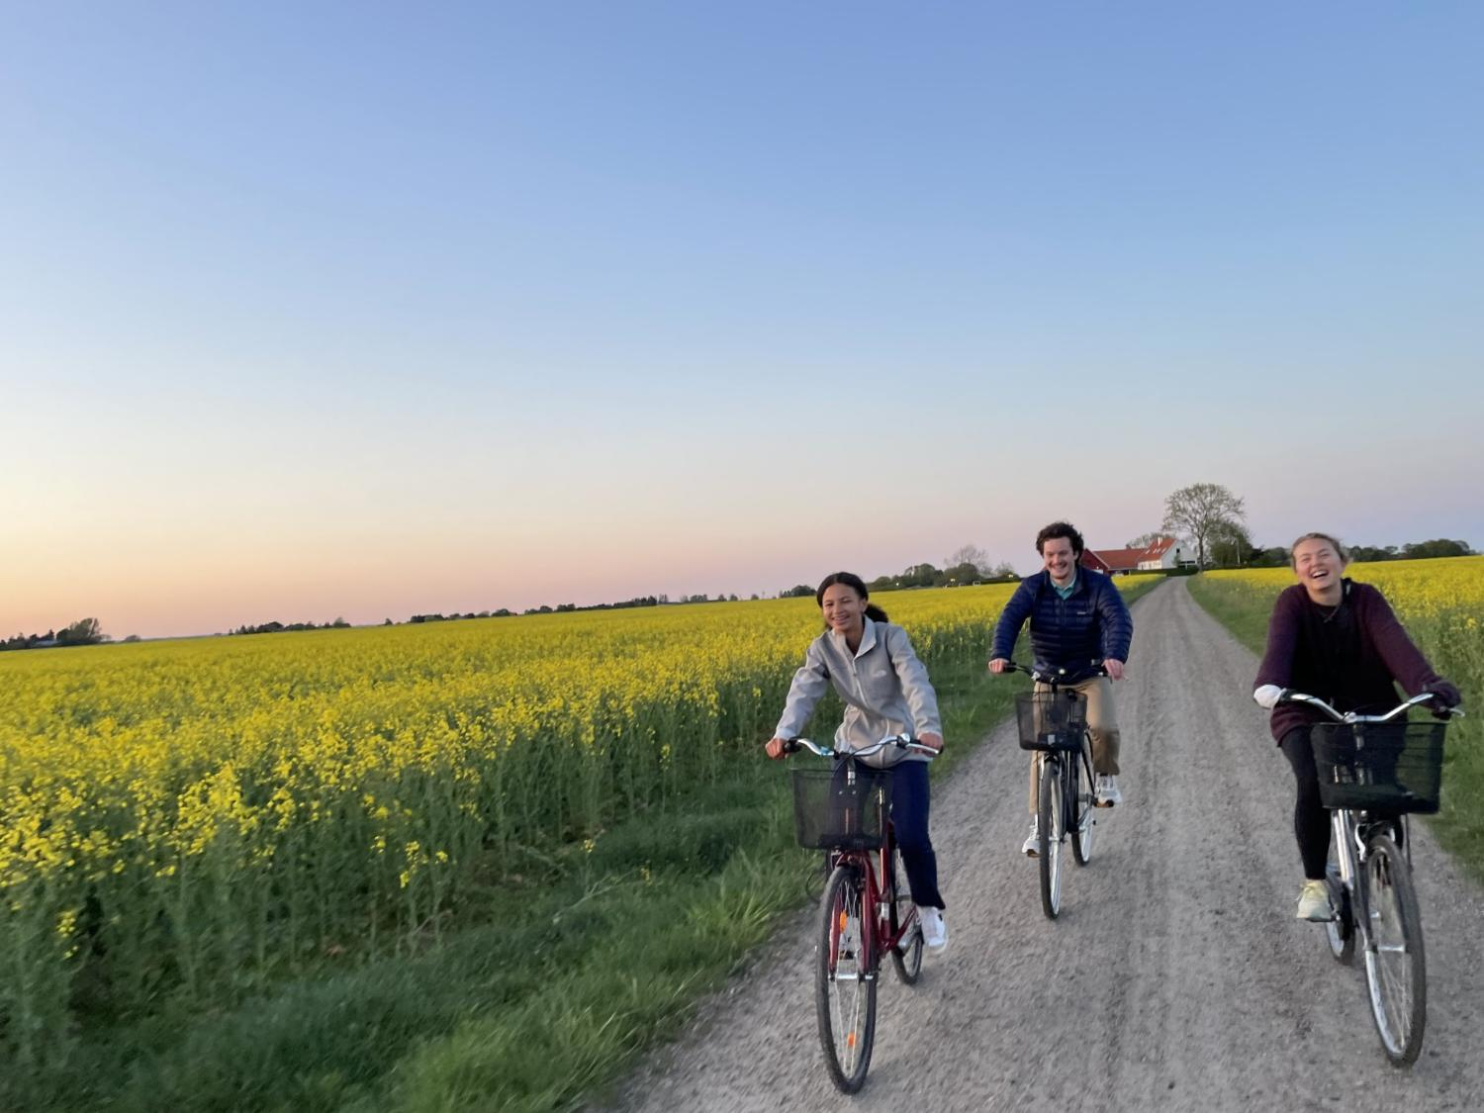
What do you do besides work on the client projects?
Interact with and receive a few talks from our IIIEE colleagues
Bike around a lot!
Tour a large scale waste handler – incinerates trash to heat Malmö
Tour Vastra Hamnen, a model of sustainable urban development built on the old site of a major shipbuilding yard
Bornholm!

Slide 29
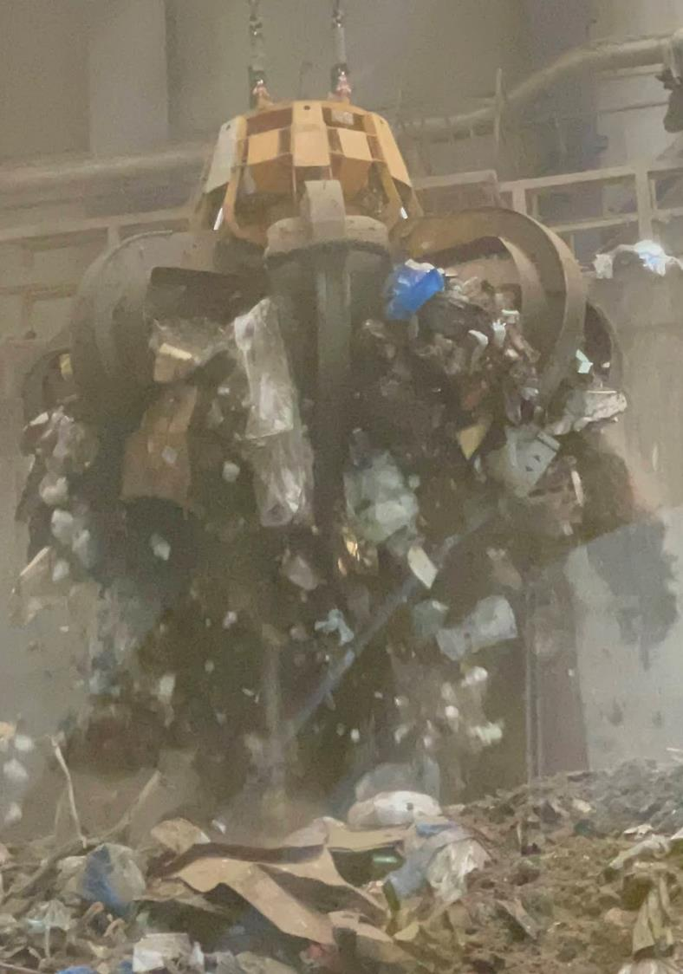
What do you do besides work on the client projects?
Interact with and receive a few talks from our IIIEE colleagues
Bike around a lot!
Tour a large scale waste handler – incinerates trash to heat Malmö
Tour Vastra Hamnen, a model of sustainable urban development built on the old site of a major shipbuilding yard
Bornholm!

Slide 30
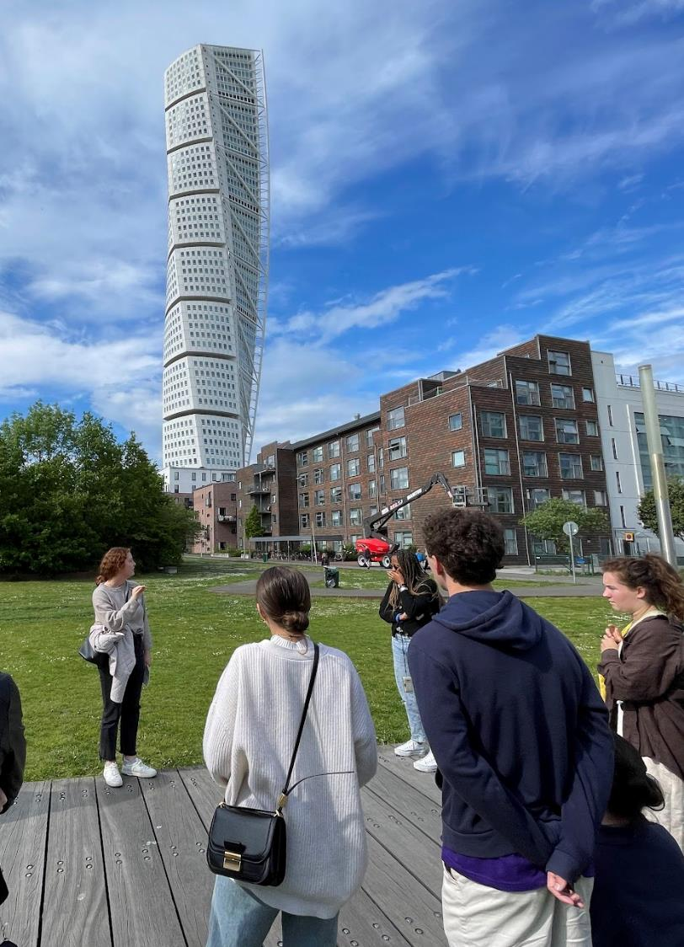
What do you do besides work on the client projects?
Interact with and receive a few talks from our IIIEE colleagues
Bike around a lot!
Tour a large scale waste handler – incinerates to heat Malmö
Tour Vastra Hamnen, a model of sustainable urban development built on the old site of a major shipbuilding yard
Bornholm!

Slide 31
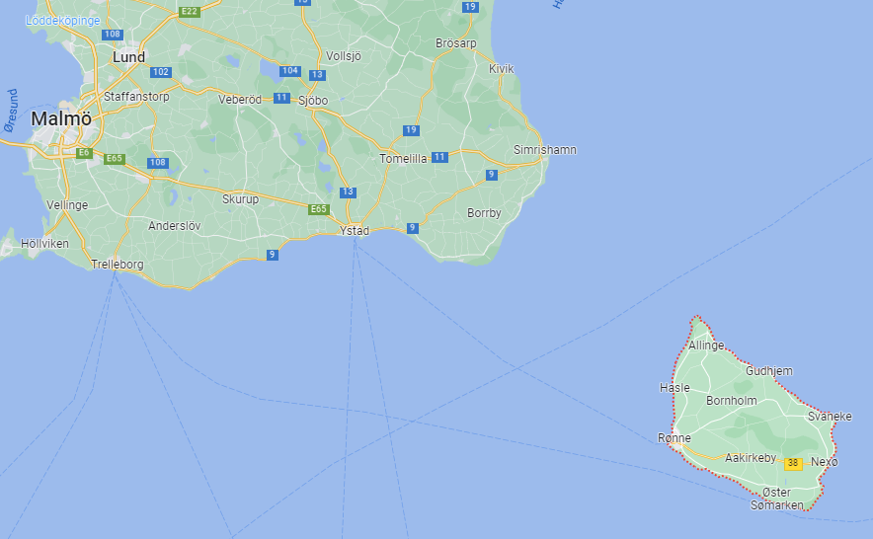
What do you do besides work on the client projects?
Interact with and receive a few talks from our IIIEE colleagues
Bike around a lot!
Tour a large scale waste handler – incinerates to heat Malmö
Tour Vastra Hamnen, a model of sustainable urban development built on the old site of a major shipbuilding yard
Bornholm!

Slide 32
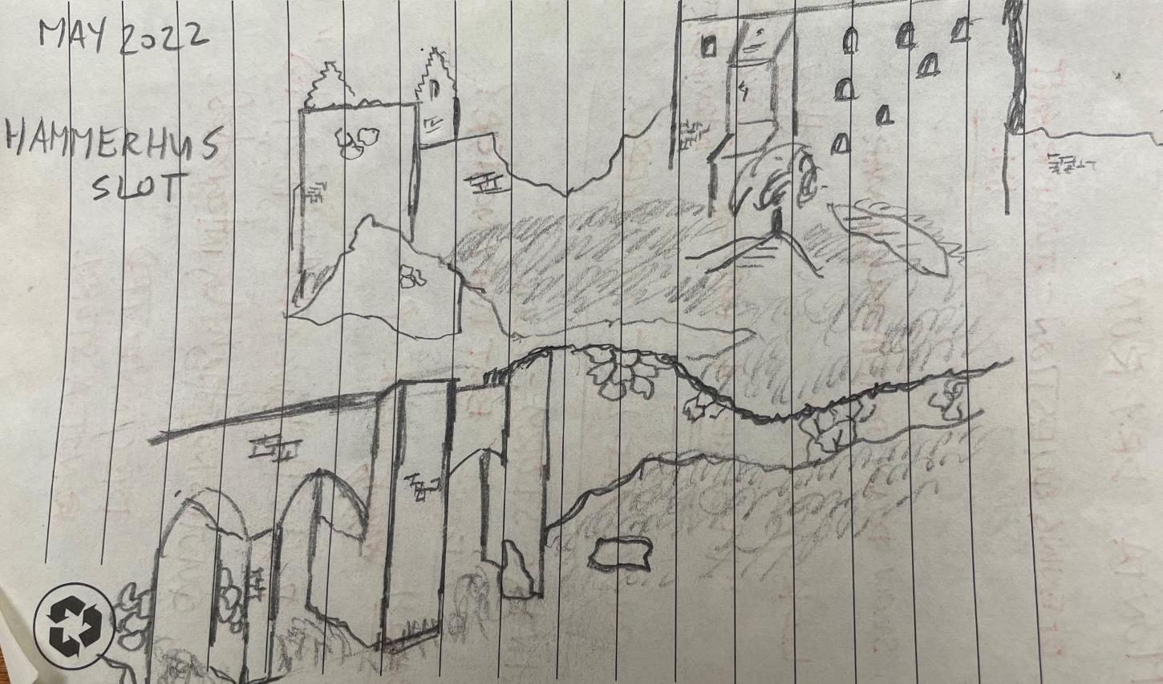
What do you do besides work on the client projects?
Interact with and receive a few talks from our IIIEE colleagues
Bike around a lot!
Tour a large scale waste handler – incinerates to heat Malmö
Tour Vastra Hamnen, a model of sustainable urban development built on the old site of a major shipbuilding yard
Bornholm!

Slide 33
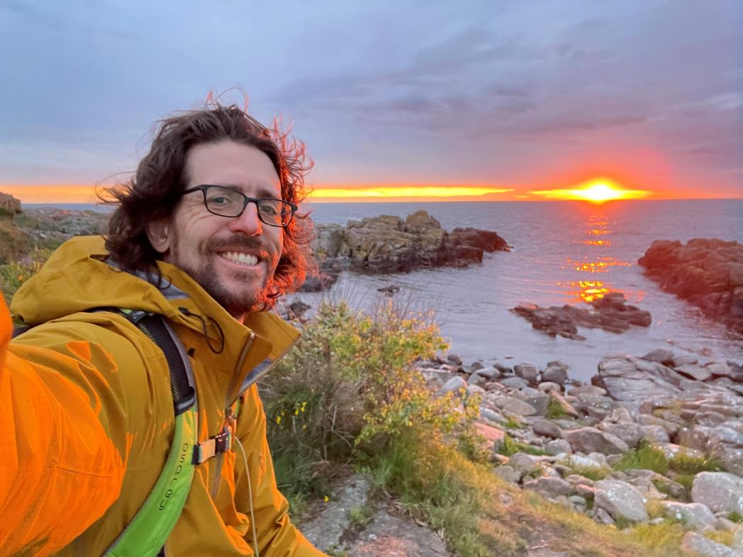
What do you do besides work on the client projects?
Interact with and receive a few talks from our IIIEE colleagues
Bike around a lot!
Tour a large scale waste handler – incinerates to heat Malmö
Tour Vastra Hamnen, a model of sustainable urban development built on the old site of a major shipbuilding yard
Bornholm!

Slide 34
FAQs

Slide 35
Dubai
Argentina
Sweden
Who
All UVA undergrads
When
J-term
J-term
May-term
Duration
2 weeks
2 weeks
3 weeks
Technology, Wine Industry
Focus
Entrepreneurship
Sustainability
SYS 3054 COMM 4293
Course Credit
SYS 3054
SYS 3054
Do I need to be in Systems?
No!
No!
No!
Apply by
Oct 1
Oct 1
March 1
Cost
$4720/$5110
$4365/$4755
$5480/$5882

Slide 36
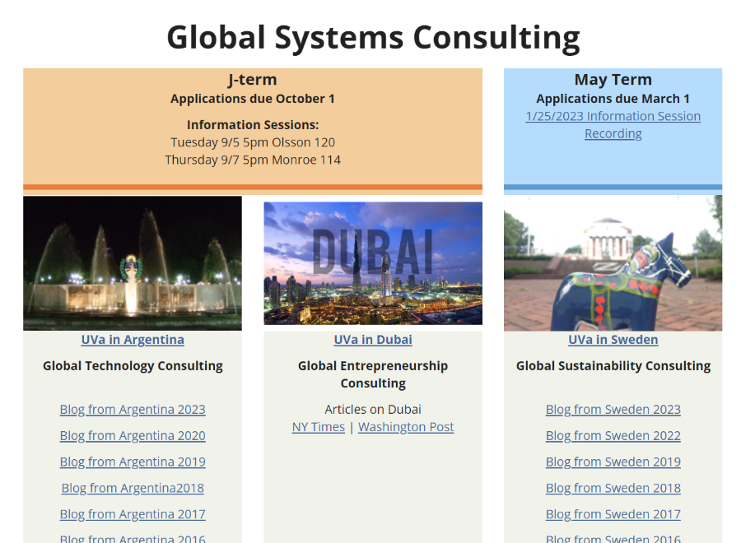
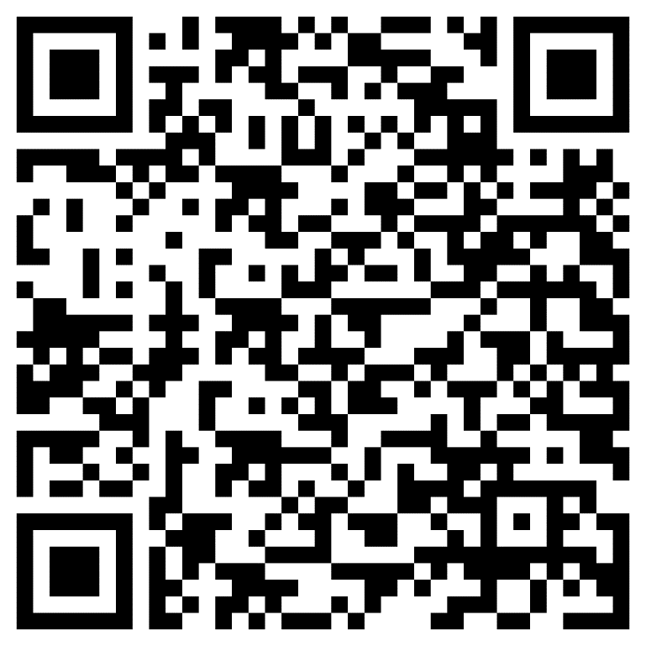
How can I learn more?

Slide 37
Systems
Global
Consulting
DUBAI
SWEDEN
ARGENTINA

